Slide 1
Week 9 Report for Systematic Literature Review
Oleg Ostapovich, Vladimir Klepikov, Mark Vishnevsky, Amir Zakirov, and Abdul Rahman Takriti

Slide 2
Goal for today
Introduction
Methodology

Slide 3
Introduction
It consist from:
  Describing topic
  Describing parts which discussed into article
  Providing idea

Slide 4
Methodology
Prisma checklist
Research Questions
Search Strategy
Search sources & query construction
Inclusion and exclusion criteria
Search process
Selection process
Data collection process
Data analysis

Slide 5
Methodology: PRISMA checklist
Section and Topic | item | Checklist item | Location where it is reported
Eligibility criteria | 1 | Specify the inclusion and exclusion criteria for the review and how studies were grouped for the syntheses | 2.5
Information sources | 2 | Specify all databases, registers, websites, organizations. | 2.4
Search Strategy | 3 | Present the full search strategies for all databases, registers and websites, including any filters and limits used | 2.3
Selection Process | 4 | Specify the methods used to decide whether a study met the inclusion criteria of the review. | 2.7
Data Collection process | 5 | Specify the methods used to collect data from reports. | 2.6
Data items | 6 | List and define all outcomes for which data were sought. Specify whether all results that were compatible with each outcome domain in each study were sought. | 2.8

Slide 6
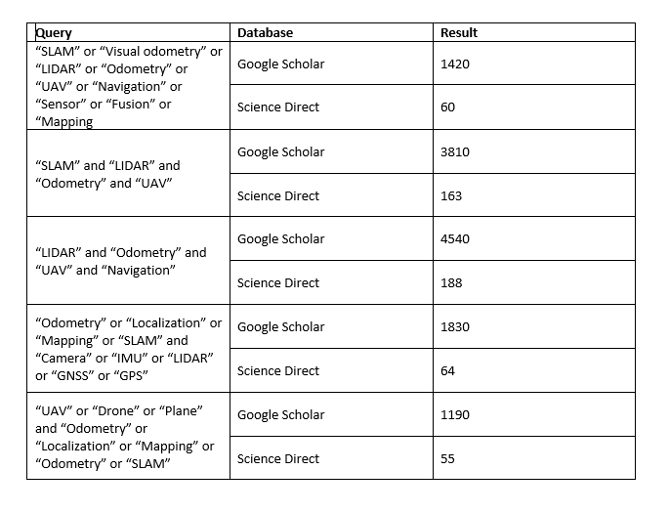
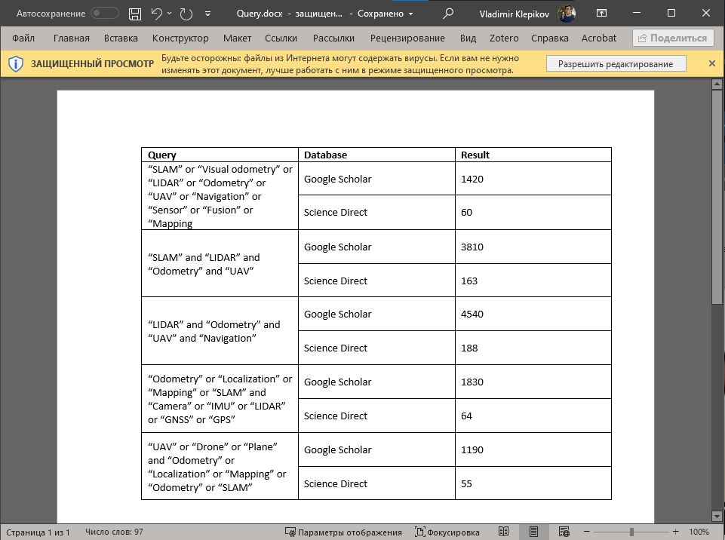
Methodology: Queries

Slide 7
Methodology: Criteria
Inclusion criteria:
[IC1] Article is published no earlier than 2017
[IC2] Free access for whole paper
[IC3] Paper written on English
[IC4] Represents materials that have examples of practical application, including tests on UAVs
[IC5] Represented hardware use same kind of sensors
Exclusion criteria:
[EC1] Duplicates should be removed.
[EC2] The main topic of a paper should correspond to the current research query.
[EC3] Type - books and conference or symposiums proceedings are not considered

Slide 8
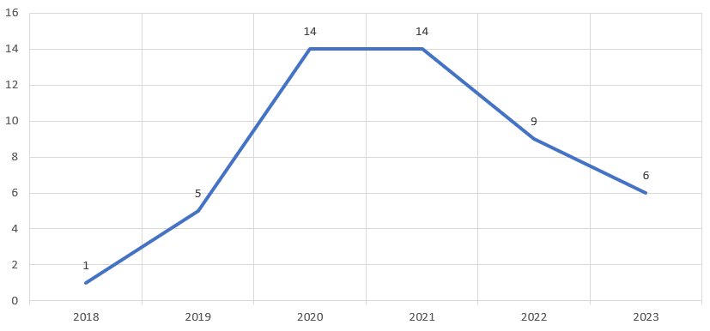
Methodology: Year graph

Slide 9
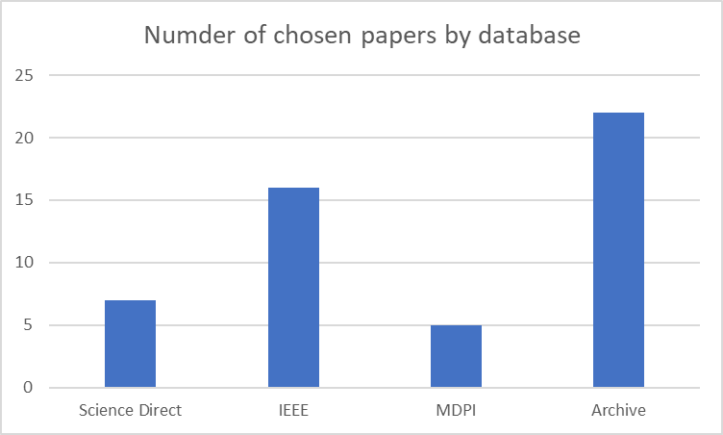
Methodology: Database graph

